Slide 1
Networks (pages 107-122)
You should be able to describe the characteristics and relative advantages of network and stand-alone computers.
You should be able to describe the difference between a Local Area Network and a Wide Area Network.
You should be able to define the Internet.
You should be able to define and give examples of Intranet, Extranet.
You should be able to explain the benefits, disadvantages and dangers of email and services such as voice mailboxes, address books; group sending; file attachments, FTP (definition and purpose), newsgroups, chatrooms, online shopping, on-line databases accessing information; search engines (selection and appropriate use).
Homework: Workbook Read page 37 answer.
Questions 1 – 9 page 121-122
Extra questions can also be found in L: drive

Slide 2
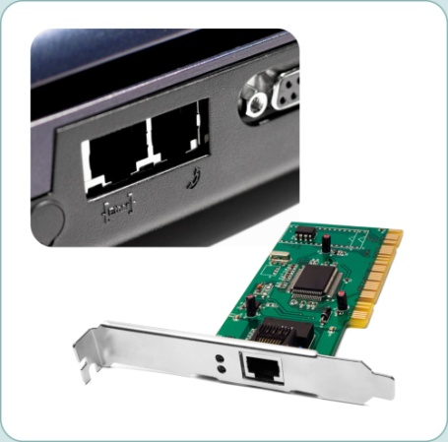
Definition of a network
Networks are groups of computers or terminals such as workstations, linked together by network cabling or by wireless links.
Each workstation has a network card
for sharing data.
A computer that is not part of a network
is called a stand-alone computer.
Stand-alone computers can only access data files stored on that computer.
They will need their own printer and other peripherals such as a scanner.

Slide 3
LAN - Local Area Network definition
What is a LAN?
A local area network is usually confined to an establishment or a small geographic area. Communication can be in the form of fibre optic, copper cabling (Ethernet) and/or wireless devices.
Linear (Bus) Network topology.
The network (including users, data files, software, hardware and backup procedures) will usually be managed on site by a dedicated team of network administrators.

Slide 4
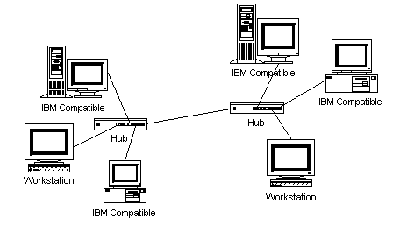
Types of local area network
There are two types of L.A.N – peer to peer and client - server networks.
Peer to peer networks do not require a central server.
Each user is in charge of their
own data which is stored on a
local disk drive and not shared.
Benefits – All computer can share a printer and Internet link.
Mostly used in homes and small offices – they are easier to manage than large systems but less secure. Each user must make their own backups.

Slide 5
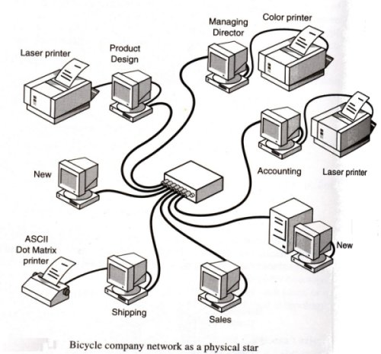
Peer to peer network topology
e.g. A peer to peer network may suit the needs of a small company.
Printers can be attached to individual computers but are normally shared between a group of computers in each department.
Different types of printer e.g. colour /mono / laser /dot matrix can be used to fulfil individual needs

Slide 6
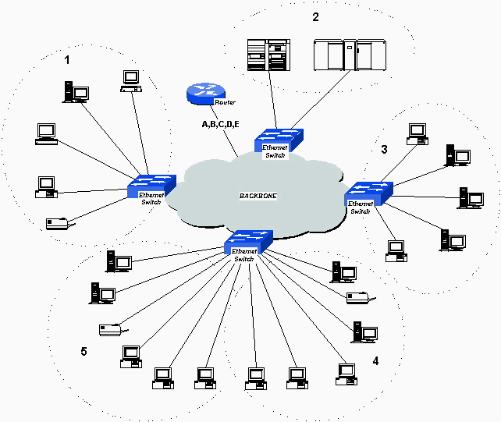
Client server network
Client server network are popular for larger networks e.g. more than 5 stations.
They require a specialised network operation software on the server. e.g. Microsoft Small Business Server.
They require specialised set up and support.
The most common topology for these networks is the star topology, with each station connected to a switch and a central file server in the middle.
Users require log on codes and passwords to log are given access rights to different parts of the system. Backup is performed centrally.
Billericay school use a server farm with thin and fat client stations.

Slide 7
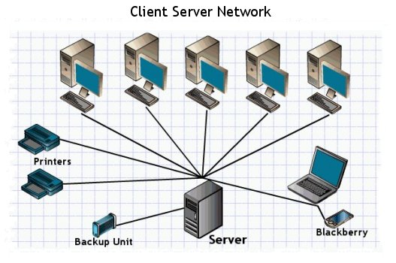
Sharing device on a network
Printers, server disk storage and Internet links are shared.

Slide 8
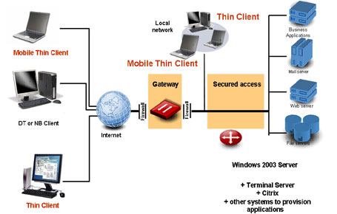
Thin client network
Thin client network use dumb terminals to connect to a central server.
Dumb terminal cannot operate on their own. (They are a window onto the programs running at the server).
A server farm allows several server to be used in tandem. Users are allocated to a server when they log on.
Benefits:
Workstation have a small footprint. All software is handled and set up centrally. Remote access users can use software not available on their own computers.
Drawbacks:
Difficult to set up. Workstations cannot be used independently.
Servers are shared so are not so fast at working with video applications that require a lot of processing power.

Slide 9
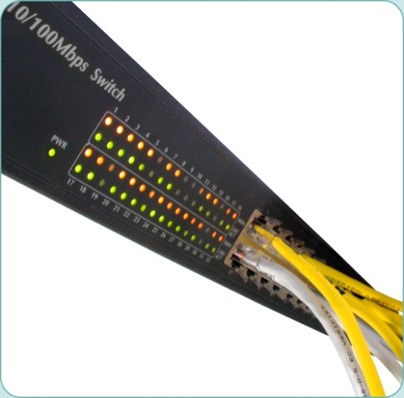
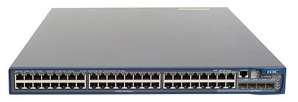
Joining network stations together
A network switch is used to join computers together via cable (cabled network)….
….or terminals may be networked using wireless technology.
A router is a gateway allowing all stations to share an Internet link.
A WEP key is needed to encrypt data on the wireless networks and keep data secure.
Network cable is more reliable and secure than wireless technology.
48 Port POE Switch
See ‘Network Hardware.ppt’ for more hardware.

Slide 10
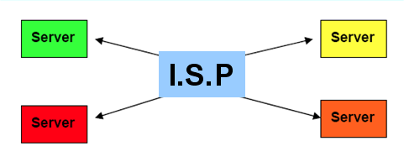
Differences between a LAN and WAN
What is a WAN?
Computers in a Wide Area Network
(WAN) are connected over a wide
geographical area, even from one
country to the other.
WANs allow LANs to be
connected together.
WANs can be public or private – e.g. Public (The Internet).
Private (A secure network owned and managed by an organisation e.g. Tesco.)
e.g. A WAN is used to connect Tesco supermarkets across the country with their central warehouse. Data regarding the sale of each item is sent daily to the warehouse using satellites. This enables the warehouse to see what needs to be loaded onto the lorry to fill the shelves for the next day.
There has been a growth in WANs over the last few years because of the development of the internet.. The falling cost of the internet and increase in speed of transmission of data is also an important contributing factor. (Its also possible to us VPN Virtual Private Network software to run a secure company networks over the Internet.)

Slide 11
Sample exam question
Exam question:
Give 2 differences between a LAN and a WAN.
Give the name of three devices that might be shared on a Local Area Network.

Slide 12
ICT AS 6th form - Theory Notes
Advantages of Networks
• Expensive peripherals can be shared. e.g. laser printers, scanners
• Data can be shared among users
Programs can be shared.
• Users can communicate with each other. e.g. Email
Shared links to the Internet can be established.
Security i.e. Access to the network is controlled. Different users can have different access rights.
Centralised backups are performed on the file server.
Users can move to different workstations – called ‘Hot desking’.
The sharing of data and peripherals make a network the only viable solution for most business users.

Slide 13
The characteristics and relative disadvantages of networks
Disadvantages of networks.
Hacking. (Overcome by the OS, firewalls, and by monitoring the system.)
Spreading of viruses. (Overcome using Antivirus software).
Power failure. (Overcome using UPS devices).
If the network server fails the whole network fails, which leads to a disruption in productivity.
Network traffic i.e. access to data may be slow – at busy periods - having a negative effect on productivity.
Additional cost of network installation and management.
Thin clients no good for heavy processing tasks.
Expensive to run as technician support is required.

Slide 14
Network Security
There are three types of network security – physical security, access security and data security.
Physical Security protects the Hardware. Some examples are:
• Serial numbers – Keep a record of all serial numbers.
• Alarms – Protect computer room with burglar alarms.
• Doors & windows – Locked when room not in use.
• Fire Protection – Use fire doors and smoke alarms
Access Security limits an individual’s use of the network:
• All authorised users should be given user names and passwords.
• Passwords should be un-guessable and should never be told to anyone or written down.
• Users should change their passwords frequently.
• Different access rights are granted to different users.
e.g network managers have complete access, teachers , medium access, other students low level access rights.
Software may be restricted to certain groups of users.

Slide 15
Network Security
Data Security prevents loss of data:
• Regular back-ups should be made of the data on the system using suitable
backup storage.
• Back-up files should be kept secure – ideally in locked, fireproof rooms or safes
in a different location to the network.
• Archiving means copying or moving files somewhere for long-term storage.
• Some software and files can be password protected.
Internet Security on a WAN requires:
• Firewalls to prevent Hacking.
• Data encryption:
i.e. Code at one end, Send in scrambled form
Decode at other end, Both ends must have codes.
• Virus and spy-ware software.
• Regular updates should be done.
Don’t open email (attachments) from unknown sources.

Slide 16
What is the Internet, Intranet and Extranet?
The Internet is an extremely large collection of networks linked together. It is a network of networks.
To connect to the Internet an ISP (Internet Service Provider) is needed, e.g. BTInternet, TalkTalk. The user can use search engines to search the World Wide Web for any subject. The pages have links to other pages. It is possible to download software, access bulletin boards or newsgroups.
Intranets:
An intranet is set up within the LAN of a school or company. Web pages can be stored on the central file server and accessed from anywhere on the network and e-mail can be sent internally within the LAN. It is not a public system.
Extranet:
An extranet is when a school or company allows access from outside to its intranet. Access would be controlled through a firewall. Passwords may be used to log on and prevent public access.

Slide 17
Sample, Exam Question
Exam question:
A teacher with good ICT knowledge in a primary school has decided to create an Intranet for the school.
Explain what is meant by an intranet.
Give one advantage to the teaching staff in having an intranet.
Give one advantage to the students of having an intranet.
Load ‘Networks – Sample questions’ and answer the question.

Slide 18
Internet services
You should be able to explain the benefits, disadvantages and dangers of:
email and services such as voice mailboxes, address books;
group sending;
file attachments, FTP (definition and purpose), newsgroups, chatrooms,
online shopping, and on-line databases,
accessing information;
search engines (selection and appropriate use).

Slide 19
The Internet
Internet: Large number of international networks, linked world wide by telecommunication lines so that data, files, emails and web pages can be shared between users.
I.S.P. - Internet Service Provider e.g. BT, TalkTalk - provides link to the Internet. Also host sweb sites for users. May provided virus control and anti spam for e-mails.
The Internet is made up of different parts \ services:
World Wide Web: Part of the internet that stores web pages. These are formatted so that they can be displayed using a browser.
E-mail - Electronic mail – requires Outlook or a www. based e-mail service.
See Activity 4 p. 116.
Chat Rooms - Multiple people on-line at the same time and in the same chat room can talk to each other. (Dangerous for youngsters?)
VOIP – Voice Over Internet – e.g. Skype -Internet telephoning.
Windows Live Messaging - On line video calls (with web cam video)
A form of video conferencing for 2 people.

Slide 20
Services available on the Internet.
Other features of the Internet
Newsgroups – e.g. Usenet - subject-oriented discussion groups for posting messages
Social Networking. - i.e. online community of people who share interests. e.g. Facebook. Most social network provide ways for users to interact, such as e-mail and chat rooms and, instant messaging services.
FTP Services: i.e. File sharing services – that allow files like Music tracks to be download and attachments to be sent.
On-line shopping – The ability to buy and sell goods on the Internet.
On-line databases – Web sites that contain information on a wide range of topics.
Accessing information – The Internet can be used to look up information on any subject you can imagine. It is important to consider the reliability of any information you find on the Internet.
Search engines - A program on the Internet that searches for items of interest. There are hundreds of search engines available on the Internet. Some are general purpose (e.g. Google, Yahoo, Alta Vista) but there are many
See Activity 1 – page 112

Slide 21
Sample, Exam Question
Q. Explain the benefits, disadvantages and dangers of the following:
email services such as voice mailboxes,
address books;
group sending;
file attachments
FTP (definition and purpose),
newsgroups,
chatrooms,
online shopping,
on-line databases accessing information;
search engines (selection and appropriate use).
Load the document ‘Networks – Sample questions’ and answer this questions.

Slide 22
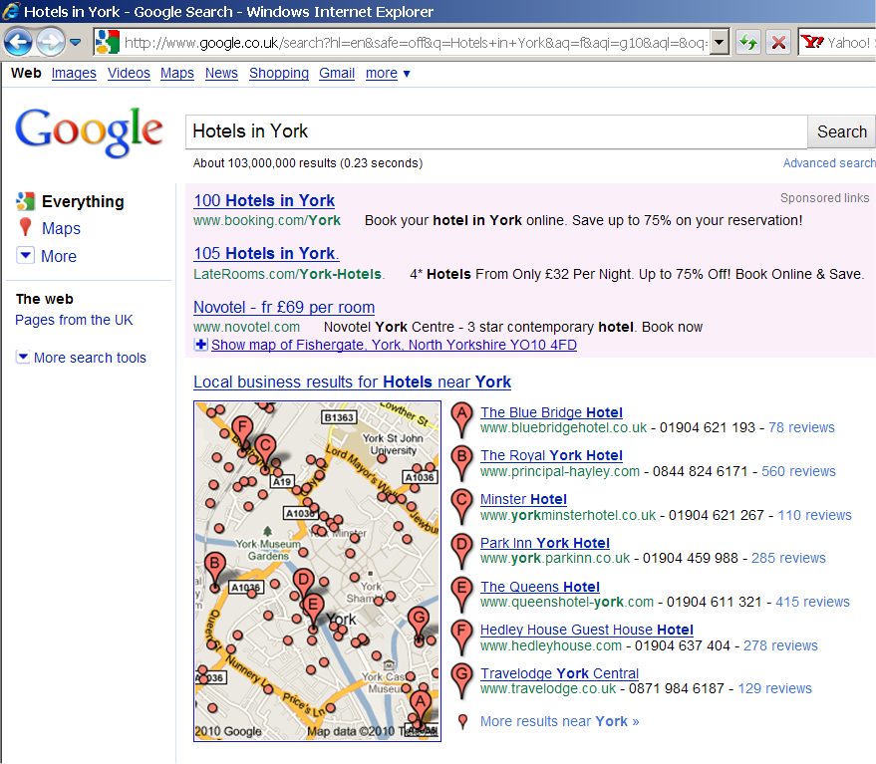
Search Engines
Benefits:
Quick to find useful websites on a given topic.
Dangers:
Can be used to direct users to given pages (for commercial interest).
Can be used to advertise!
Often give too many results – with outdated pages in.
May miss out some very good sources of information.

Slide 23
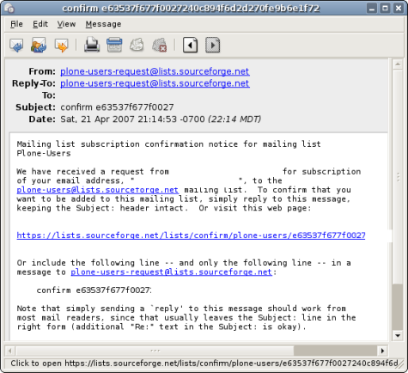
E-mail Software
Benefits?
Quick to send, Cheap,
Don’t require paper
Person does need to be on-line.
Can attach files.
Problems?
Viruses,
Spam
Phising e-mails –
with misdirected links.
Privacy?
Privacy is not guaranteed.

Slide 24
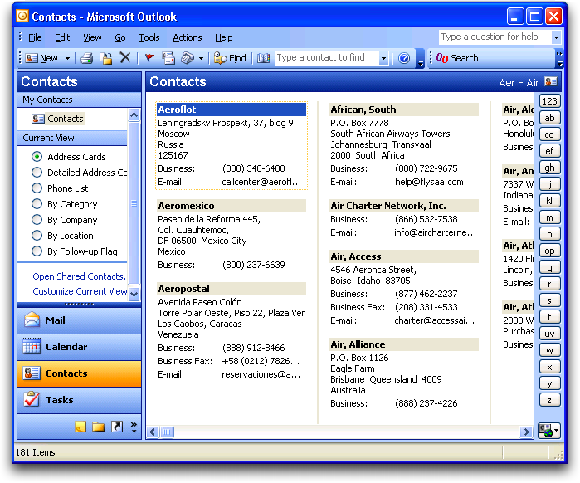
E-mail - Address book
Central contacts list.
You can create groups for different types of contact.
You can send a batch of e-mails to a whole group.

Slide 25
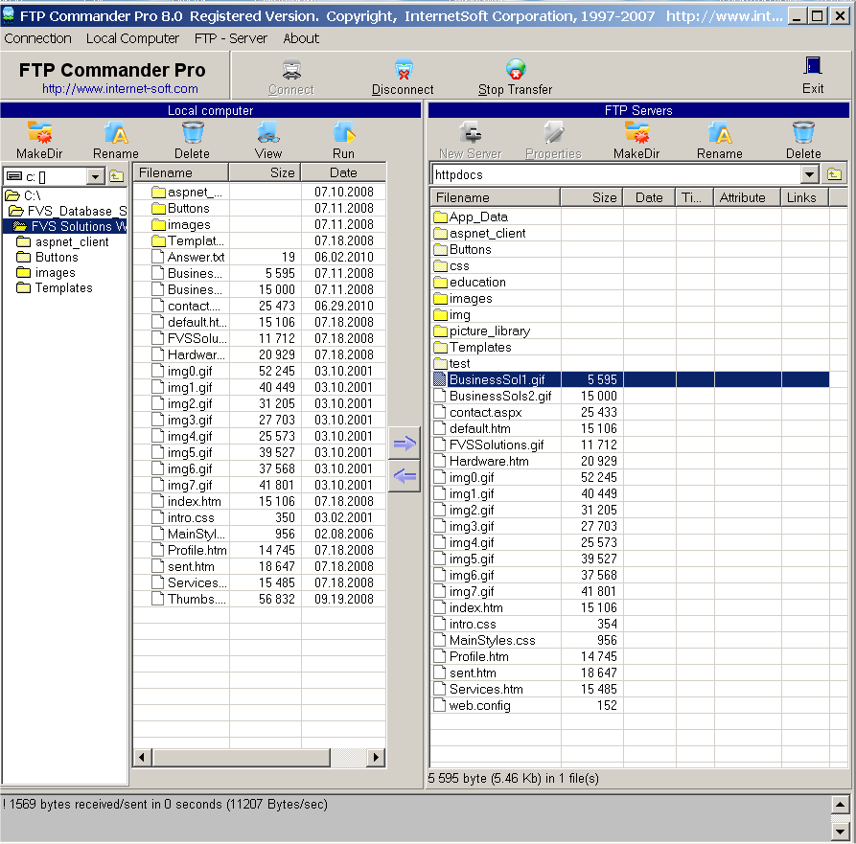
Using an FTP program
FTP Commander:
allows to modify the files on a remote computer.
You can upload or download files between computers.
Benefits?
Problems?

Slide 26
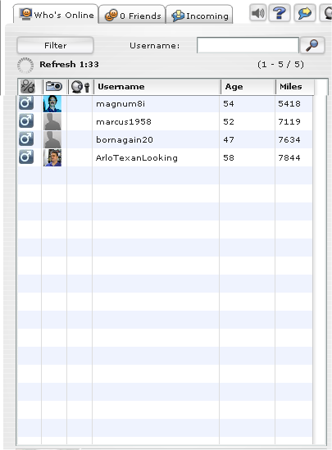
On-line chat rooms
Instant Messenger
You can see who is on-line.
You can join a group with a particular interest.
Benefits?
Problems?

Slide 27
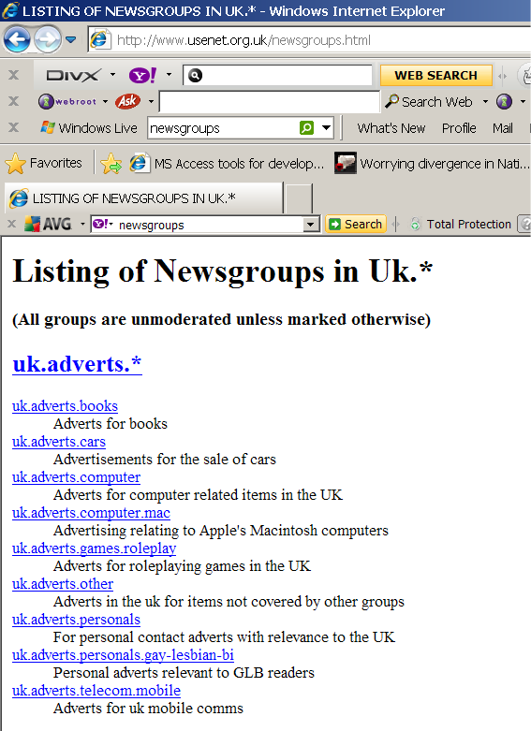
Newsgroups
Index of Newsgroup from Google
You can post messages for others to read that fit in with the policy of the newsgroup.
Benefits?
Problems?

Slide 28
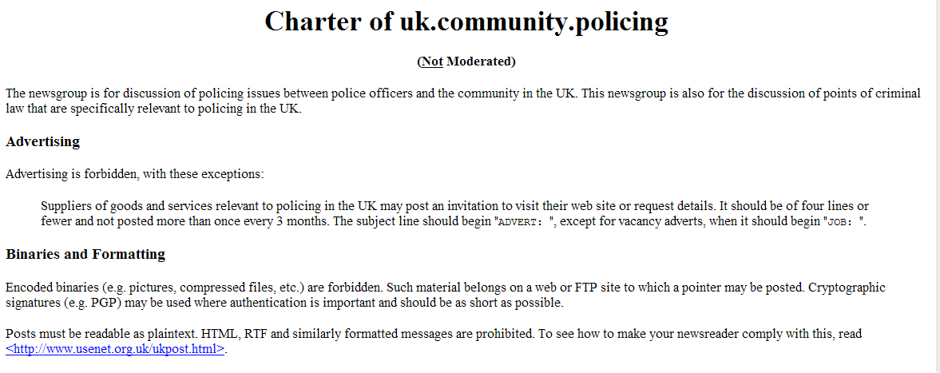
Newsgroup – Rules for posting
Postings are checked by the administrator.

Slide 29
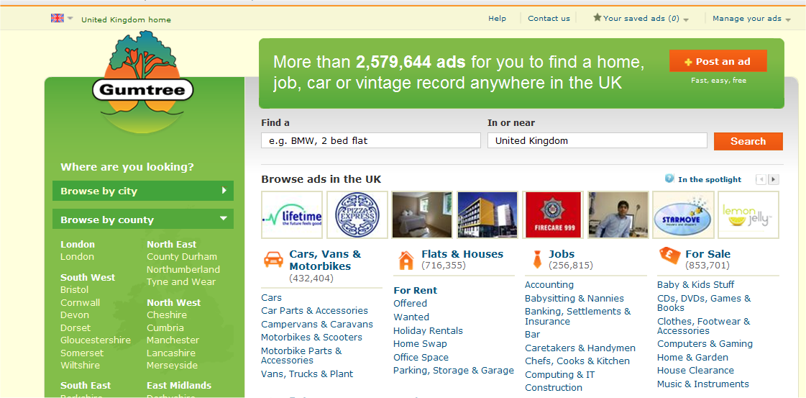
On-line databases
With Gumtree you can post an on-line advert. Go to www.gumtree.co.uk

Slide 30
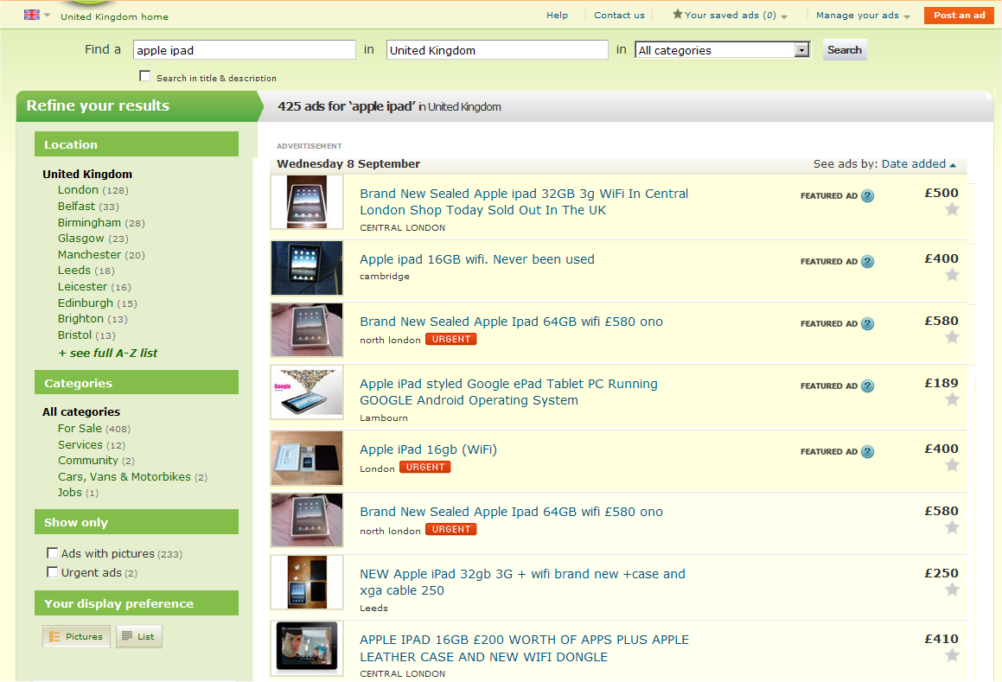
Gumtree - Searching for an ipad?

Slide 31
Sample, Exam Question 2
A software developer is working as part of a team of 10 developers who are developing new software for an on-line loan company. The team members work in different parts of the country.
They need to keep in touch with each other an need to pass work to each other.
Explain 3 advantages of them contacting each other by email rather than post.
2. Describe 2 facilities provided by email software that will mean it a lot easier to work as a team.

Slide 32
ICT AS 6th form - Theory Notes
Exercise
Read the summary on page 121
Complete Q. 1-8 on page 121-122.

